Slide 1
Chongqing University of Technology
ATAI
Advanced Technique of Artificial Intelligence
Chongqing University of Technology
Low-Resource Dialogue Summarization with Domain-AgnosticMulti-Source Pretraining（EMNLP_2021）
Yicheng Zou,, Bolin Zhu
, Xingwu Hu, Tao Gui, Qi Zhang
Institute of Modern Languages and Linguistics, Fudan University
Shanghai Key Laboratory of Intelligent Information Processing, Fudan University
School of Computer Science, Fudan University
Shanghai, China
{yczou18,blzhu20,xwhu20,tgui,qz}@fudan.edu.cn
2021.11.8 • ChongQing
Reported by Lele Duan
Code & dataset:https://github.com/RowitZou/DAMS

Slide 2
Chongqing University of Technology
ATAI
Advanced Technique of Artificial Intelligence
Chongqing University of Technology
1.Background
2.Method
3.Experiments

Slide 3
Background
There is a growing demand for dialogue summarization.
Inadequacy of dialogue data with annotated summaries.
Directly pretrain models in other domains, e.g., the news domain.
Neglect the huge difference between dialogues and conventional articles.
Introduce a novel pretraining paradigm called domain-agnostic multi-source pretraining (DAMS) .

Slide 4
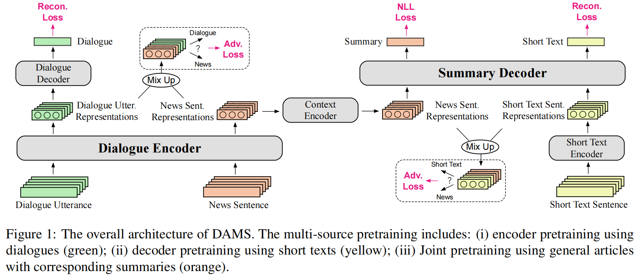
Method
Over view

Slide 5
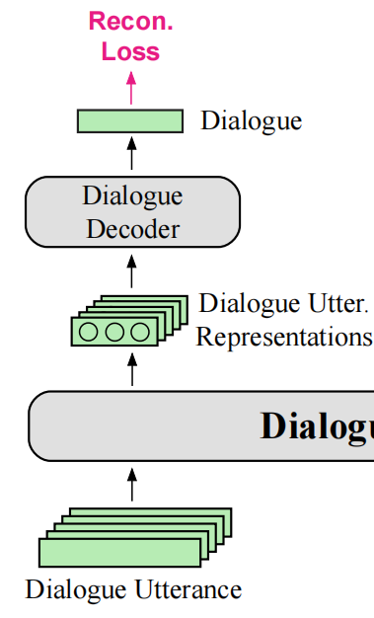
Method
Pretraining of dialogue modeling
To incorporate multi-party information, we add the name of the speaker at the beginning of each utterance. Then, we tokenize utterances into word sequences, denoted as:
Where is the word in the sequence of .
Randomly mask 15% of the tokens in each utterance with a special [MASK]
Concatenate a special token [CLS] in front of each sequence
[CLS] :Used as the aggregate sequence representation for utterance reconstruction.

Slide 6
Method
Pretraining of dialogue modeling
Formally, we transform the modified noisy sequence
into a sequence of hidden vectors by a Transformer encoder:
Transformer decoder
Transformer encoder

Slide 7
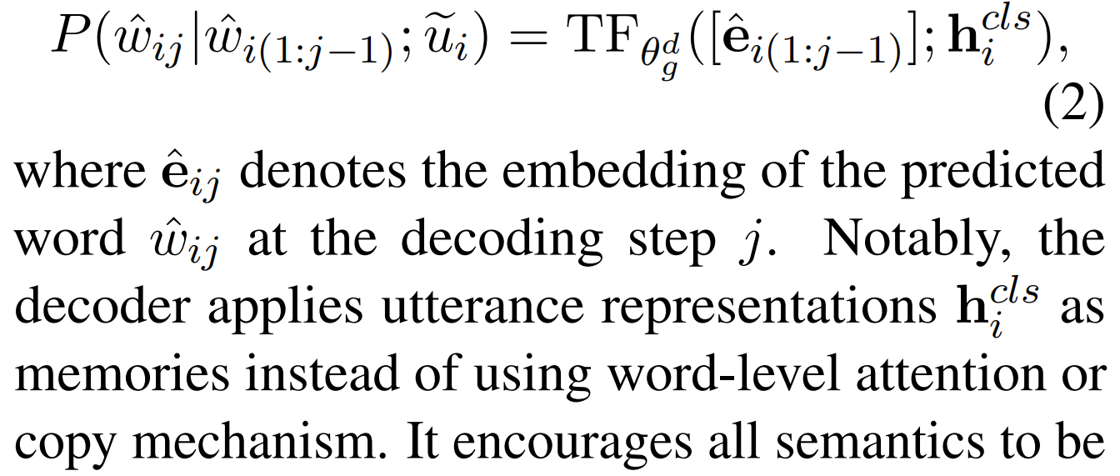
Method
Pretraining of dialogue modeling
Recovers the original utterance conditioned on the input representation .
Transformer decoder is a variant that removes the
decoder-encoder attention layer, Formally, the
generation probability is defined by:
Transformer decoder
Transformer encoder

Slide 8
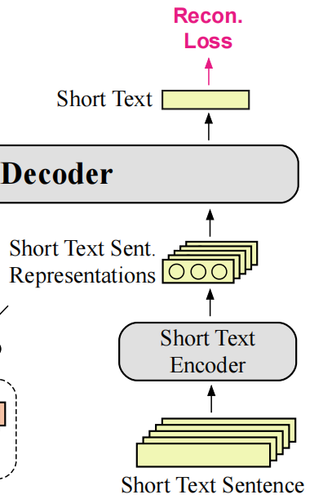
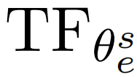
Method
Pretraining of summary language modeling.
Here, we use daily life short texts or stories to train the decoder to generate texts in the style of dialogue summaries.
truncate
form
Long documents
training samples
text pieces
Given , we use the same noise ,addition strategy as for dialogues
to construct noisy sentences, and encode them into hidden vectors by a Transformer encoder :
To further capture the global semantic dependency between sentences:

Slide 9
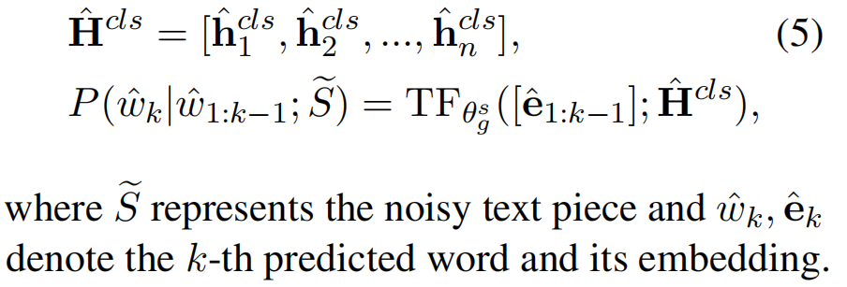
Method
Pretraining of summary language modeling.
The generation probability is:
Finally, we train the language model conditioned on as:

Slide 10
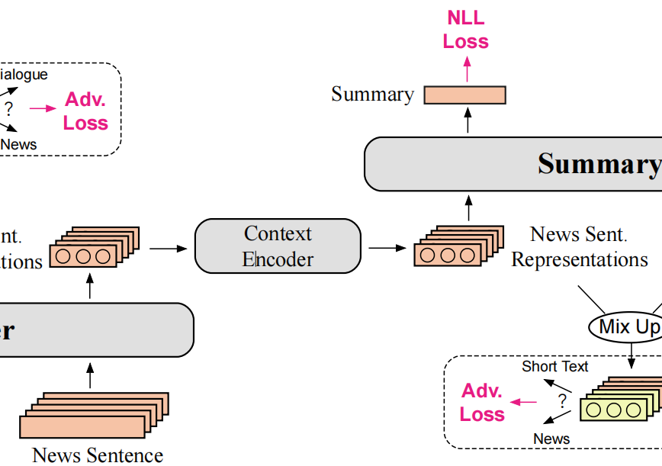
Method
Pretraining of abstractive summarization
has the same architecture as in Eq.4. Then, we input sentences of a document into and get a predicted summary from , training the model with the following objective:

Slide 11
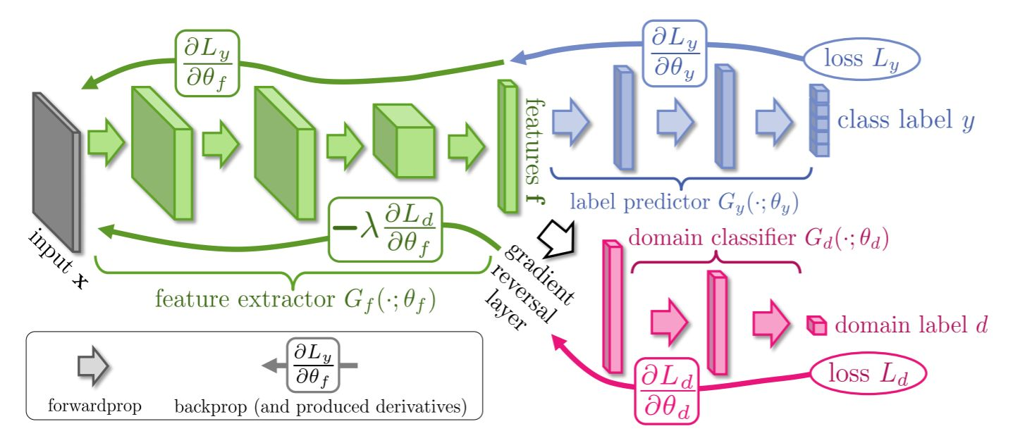
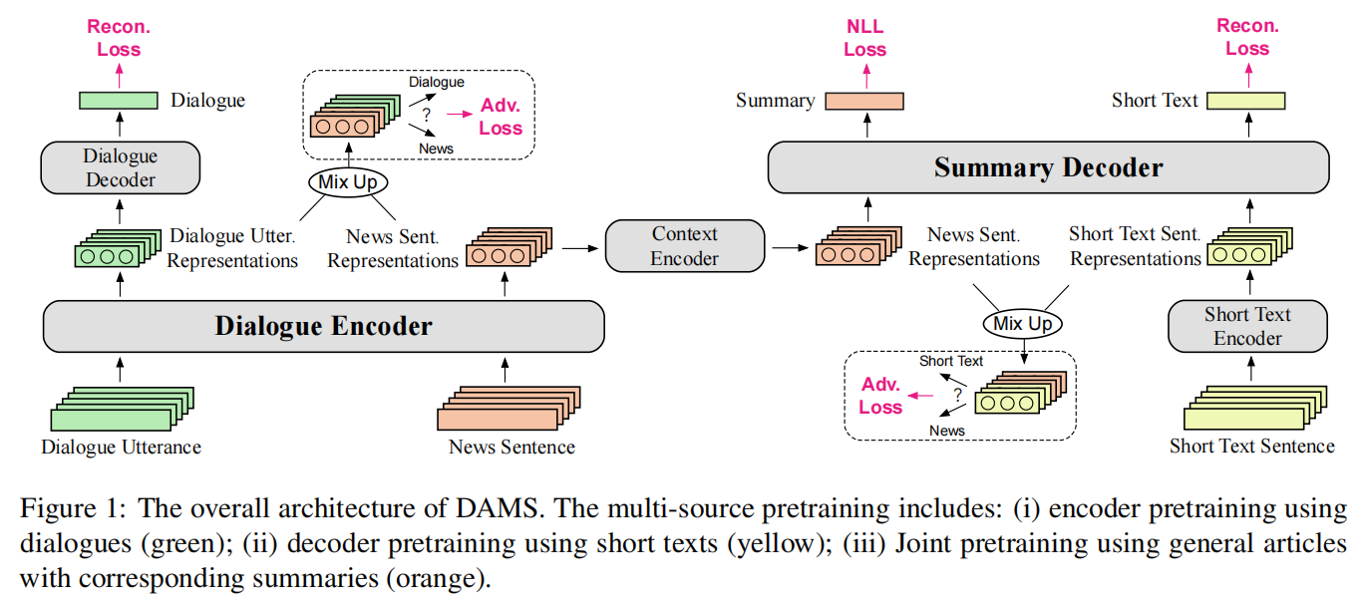
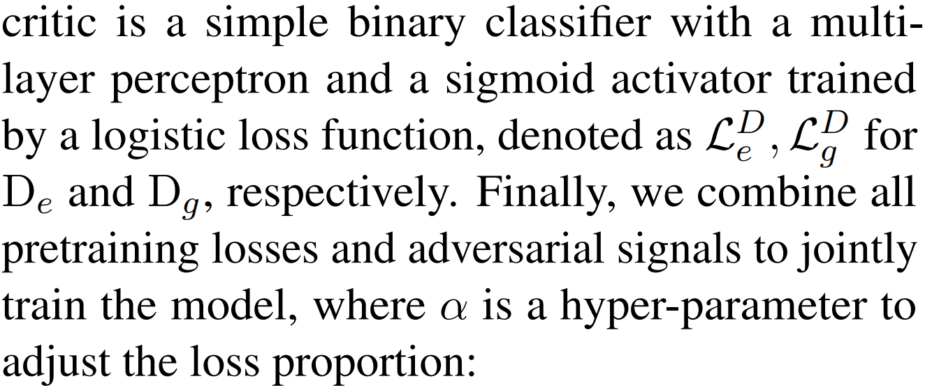
Method
Domain-Agnostic Summarization with Adversarial Learning
rather than domain-specific attributes : To result in the domain-invariant features and encouraging the summarizer to only focus on content
2015_JMLR_Unsupervised Domain Adaptation by Backpropagation

Slide 12
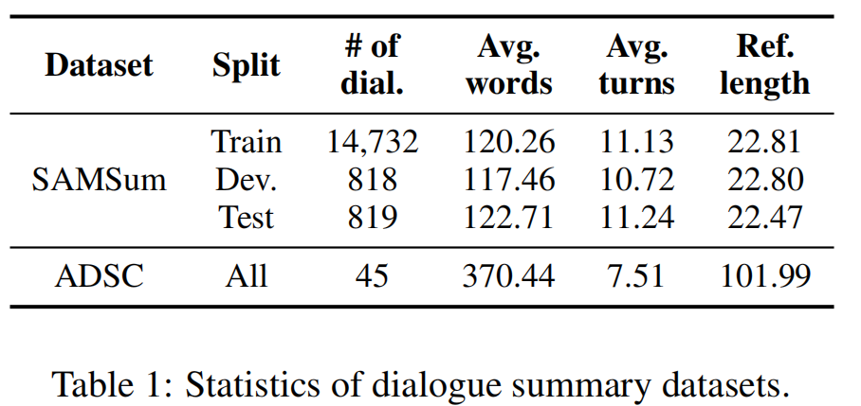
Experiment

Slide 13
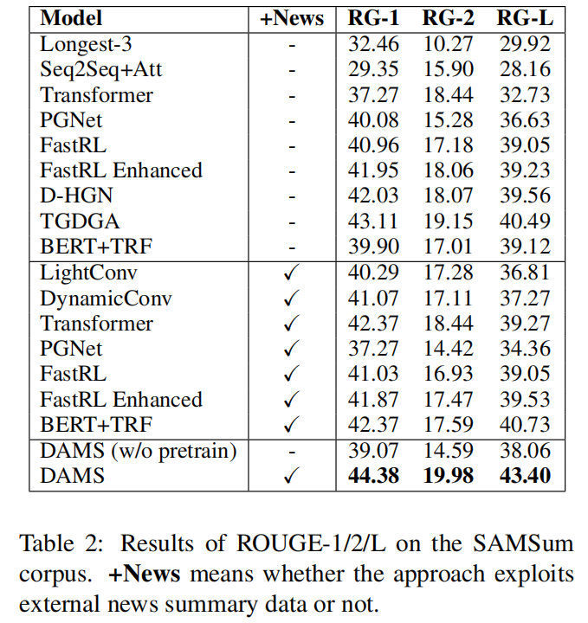
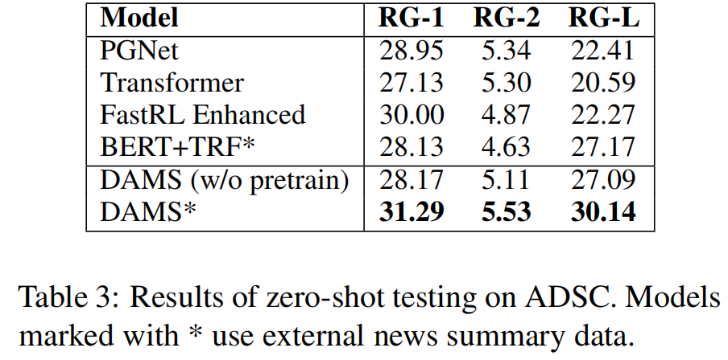
Experiment

Slide 14
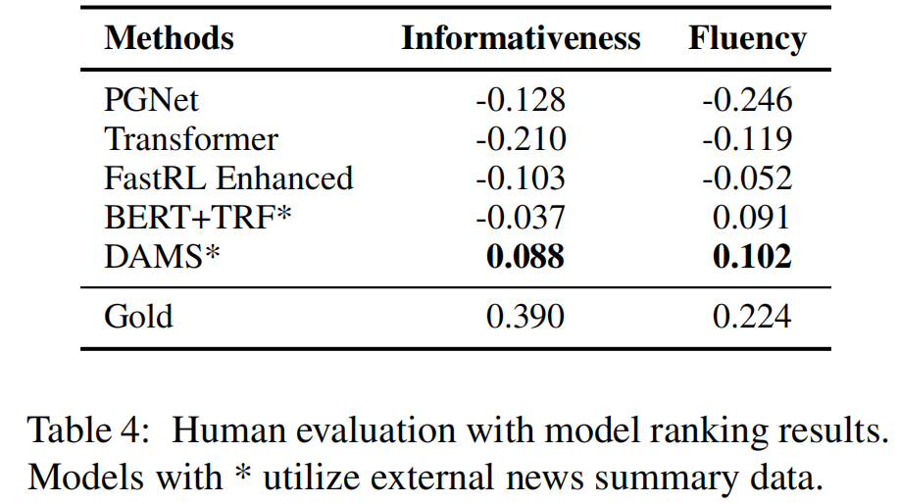
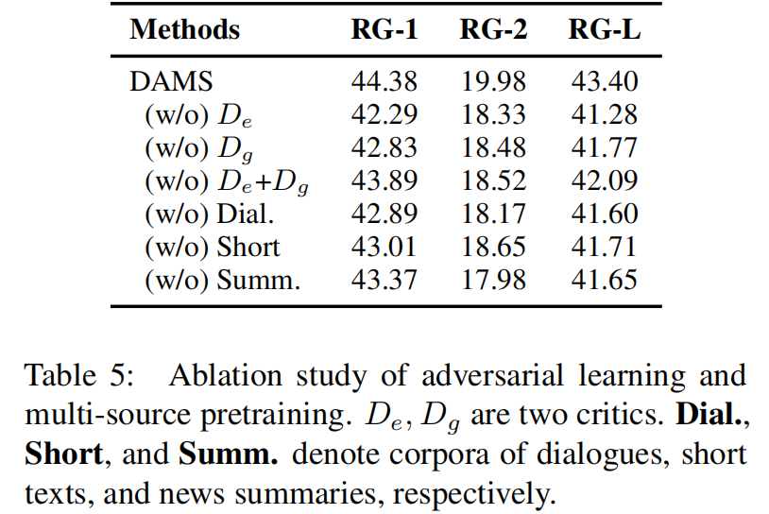
Experiment

Slide 15
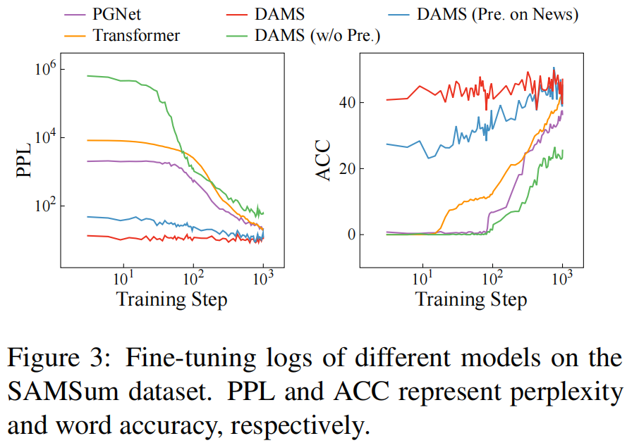
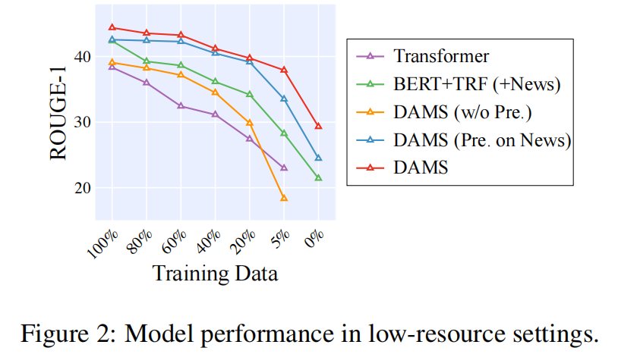
Experiment

Slide 16
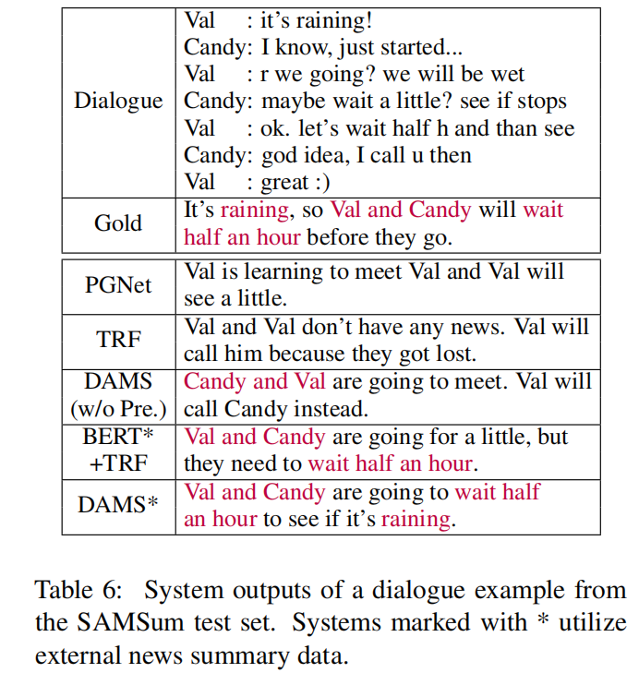
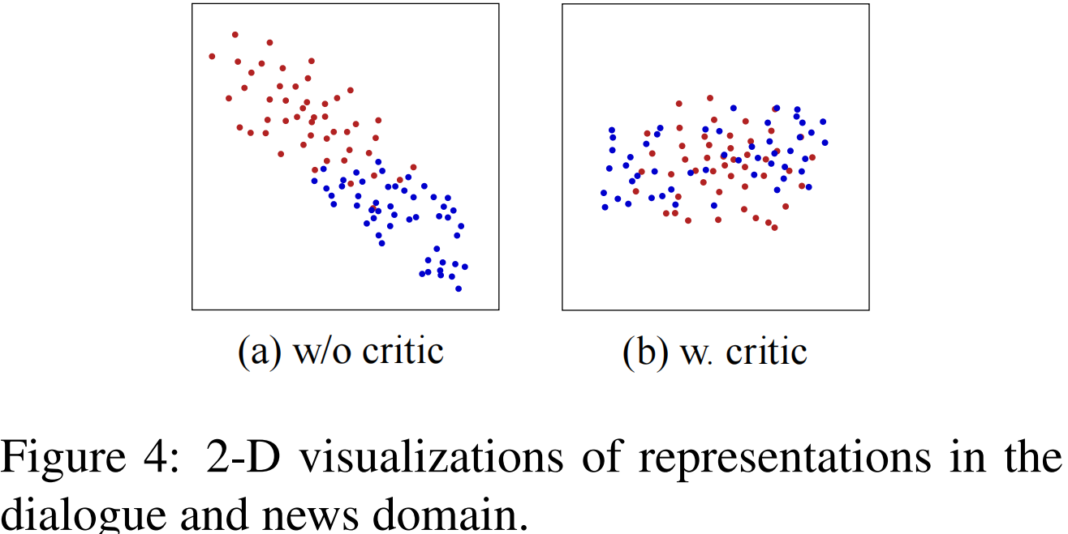
Experiment

Slide 17
Chongqing University of Technology
ATAI
Advanced Technique of Artificial Intelligence
Chongqing University of Technology
Thank you!

